Slide 1
Neurological Disorders Lesson 1.4
How do our brains interpret the environment?

Slide 2
Do Now
Review last night’s homework with a partner.

Slide 3
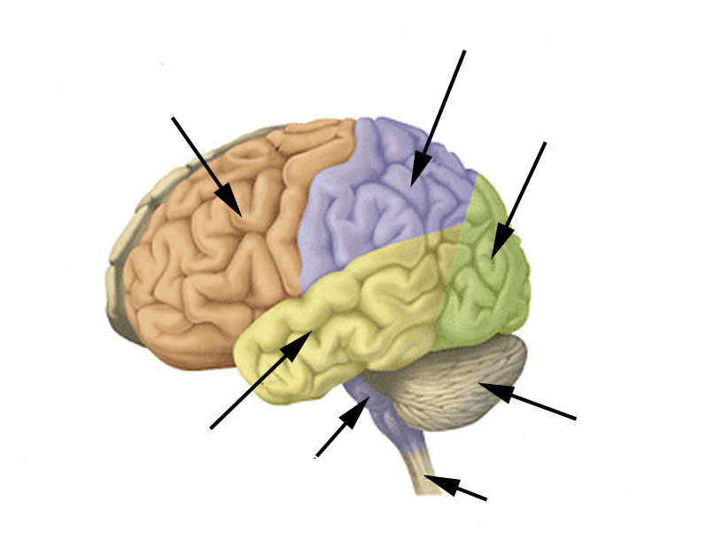
The Five Senses in our Brains
Which lobe is responsible
for vision?
Parietal lobe
Frontal lobe
Occipital lobe
Vision
Temporal lobe
Cerebellum
Brainstem
Spinal Cord

Slide 4
The Five Senses in our Brains
Which lobe is responsible
for touch?
Parietal lobe
Touch
Frontal lobe
Occipital lobe
Vision
Temporal lobe
Cerebellum
Brainstem
Spinal Cord

Slide 5
The Five Senses in our Brains
Which lobe is responsible
for hearing?
Parietal lobe
Touch
Frontal lobe
Occipital lobe
Vision
Temporal lobe
Cerebellum
Hearing
Brainstem
Spinal Cord

Slide 6
The Five Senses in our Brains
Which lobe is responsible
for smell?
Parietal lobe
Touch
Frontal lobe
Occipital lobe
Vision
Temporal lobe
Cerebellum
Hearing
Brainstem
Smell
Spinal Cord

Slide 7
The Five Senses in our Brains
Which lobe is responsible
for taste?
Parietal lobe
Touch
Frontal lobe
Taste
Occipital lobe
Vision
Temporal lobe
Cerebellum
Hearing
Brainstem
Smell
Spinal Cord

Slide 8
Sensation and Perception
What is sensation?
The immediate and basic experience generated when stimuli active our sensory systems.
What is perception?
The interpretation of sensations.
What is the difference?
Perceptions vary widely among us.
Sensations are pretty constant among us.

Slide 9
Now, a short demonstration of sensation and perception…
Notes:
If you are having difficulties playing this video through the PowerPoint slide, you can access it online at: http://sites.tufts.edu/greatdiseases/modules/neurological-disease/multimedia-backup/ or
http://www.youtube.com/watch?v=vJG698U2Mvo

Slide 10
Perception in our Brains
Parietal lobe
Touch
Frontal lobe
Taste
Resolves conflicts between different sensory inputs
Occipital lobe
Vision
Insular cortex (inside)
Resolves discrepancies between what we see and touch
Temporal lobe
Cerebellum
Hearing
Brainstem
Smell
Spinal Cord

Slide 11
Sensation and Perception Station Lab

Slide 12
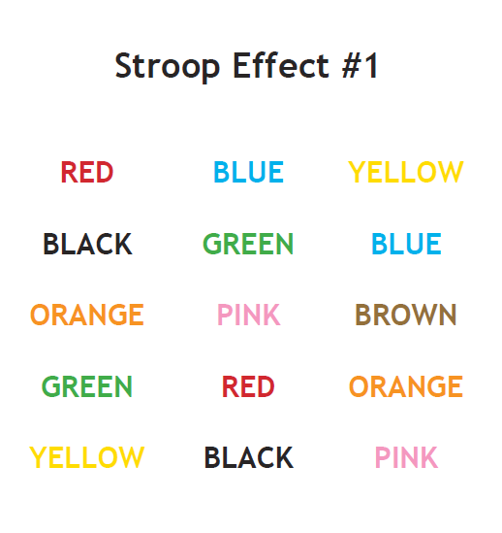
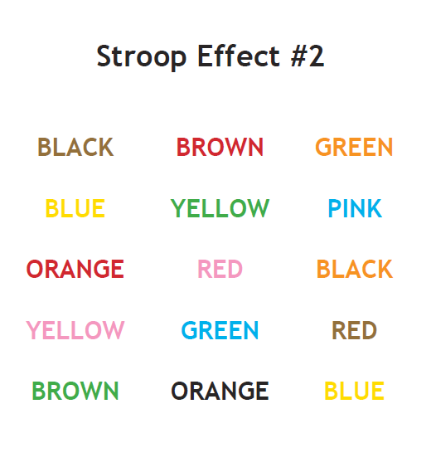
Wrap Up: Why are our brains tricked?
Our brains are receiving conflicting sensory information, and they are doing their best to explain these conflicting senses.

Slide 13
Station #5 Auditory
Octave Illusion
http://en.wikipedia.org/wiki/Octave_illusion

Slide 14
Station #5 Auditory
McGurk Effect
Notes:
If you are having difficulties playing this video through the PowerPoint slide, you can access it online at: http://sites.tufts.edu/greatdiseases/modules/neurological-disease/multimedia-backup/

